Slide 1

Is WASM Too Soon or Too Late? Next Generation's Perspective
Tuesday 5 September 2023
Ashwin Kumar Uppala @ashwinexe
@CivoCloud

Slide 2

I’m Ashwin
Building GitHub Octernships
Coach @ Major League Hacking
Co Founder | Hackerabad
Always on social media
Ashwin Kumar Uppala Associate Program Manager
GitHub
@CivoCloud

Slide 3
I’m Ashwin
@ashwinexe
Twitter X
GitHub
Linkedin
Hashnode
Bluesky
Ashwin Kumar Uppala Associate Program Manager
GitHub
@CivoCloud

Slide 4
Show of hands
How many of you have tried WASM?
@CivoCloud

Slide 5

Show of hands
How many of you have tried WASM?
@CivoCloud

Slide 6
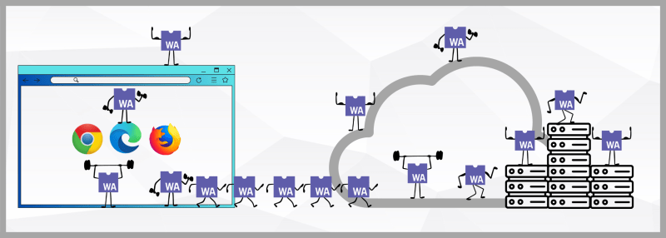
What is WASM?
Source: https://nigelpoulton.com/
@CivoCloud
Notes:
Briefly explain WASM WASM stands for WebAssembly. It is a binary instruction format designed for safe and efficient execution on web browsers.
WASM analogy with game startup (Puzzle game)
WASM is a binary instruction format that can be executed natively by web browsers. This means that WASM applications can be much faster and more efficient than traditional JavaScript applications. WASM can also be used to create more complex and demanding web applications.

Slide 7
Where I started?
A WASM+EDGE talk in Open Source Summit NA 2023
It made me curious
Curiousity != Motivation
@CivoCloud
Notes:
Briefly explain WASM IDK WASM or EDGE
the new tech made me very very curious
But curiosity wasn't enough to

Slide 8
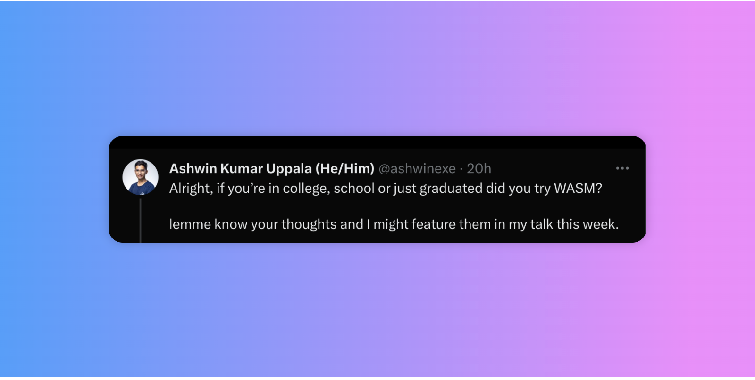
@CivoCloud
Notes:
I got people sharing how they started,

Slide 9
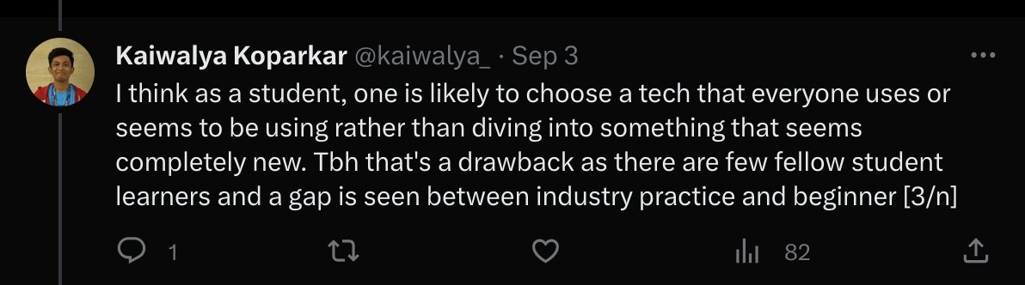
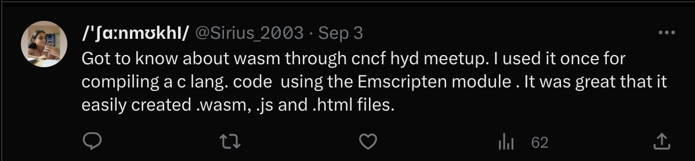
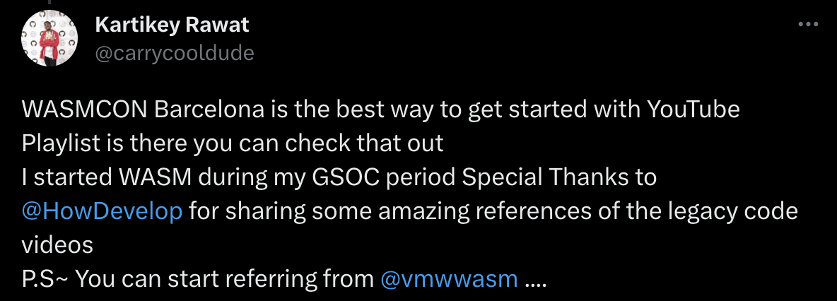

Slide 10
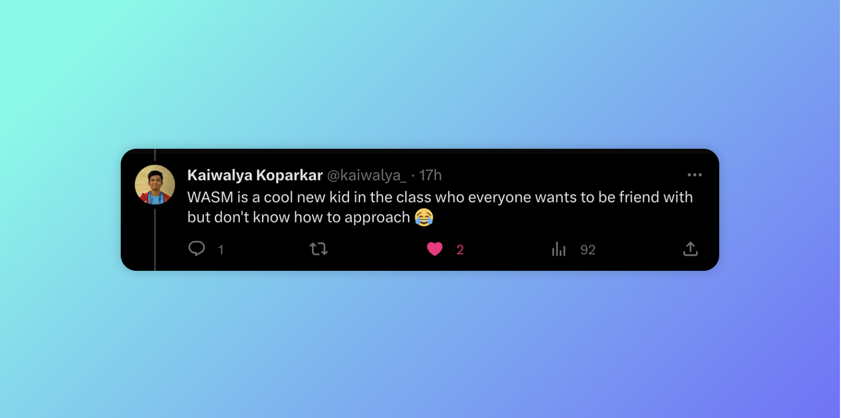
@CivoCloud

Slide 11
Challenges
Do we have community for everyone…?
WASM does not have matured debugging tools, yet.
Very close to board the hype 🚄
@CivoCloud
Notes:
1. We don’t
2. It’s difficult to debug and understand what happens during WASM runtimes if there’s no debugging tools!
3. Hype train is part of the process it’s neither good nor bad. How do we prepare for the scale when the train arrives.
Solution: A framework which promotesa healthy evolution of WASM.

Slide 12
”Don’t buy stars, build them”
What can we do to bring more talent to WASM?
Start with a self-sustainable community framework.
People need a shared struggle
@CivoCloud
Notes:
My experience in building a community in Octernships

Slide 13

Piñata
Notes:
This is a pinata, a decorated figure. strongly identified with Mexico and spanish culture.
The Piñata game is very popular where you stuff the figure with candies.

Slide 14


Piñata
Notes:
This is a pinata. strongly identified with Mexico and spanish culture.
The Piñata game is very popular where you stuff the figure with

Slide 15
The Piñata Effect
Project
Maintainer
Users

Slide 16
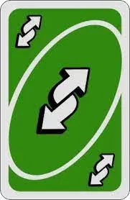
The Piñata Effect
Project
Maintainer
Users

Slide 17
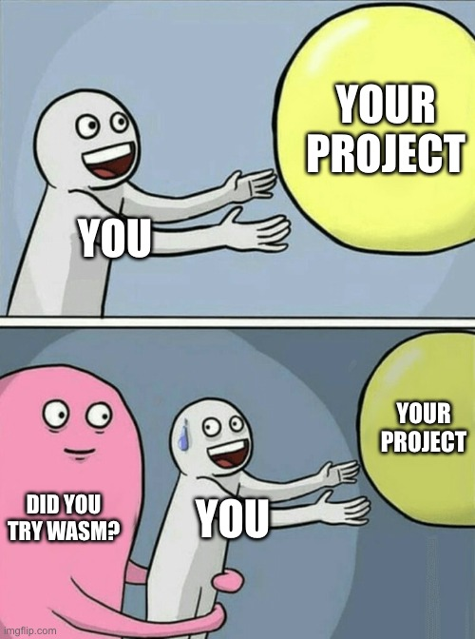
Rethink the way we deliver
@CivoCloud
Notes:
Talk about how’s the current status of WASM in tech.

Slide 18
WASM Demographics?
Contributor – User - Creator
Overall, 37% of end user organizations have some experience deploying applications with WebAssembly. CNCF Annual Survey 2022
@CivoCloud

Slide 19
Words from the next gen
People who love to code for fun
“its not bad, i've tried doing like unity compiling to wasm for react and the game actually runs really nice”
“It worked really well, all things considered. Even Rust-JS interop wasn’t that bad.”
“I had a use case where it needed to do heavy astronomical calculations
WASM was ALOT faster than js”
“I haven't personally interacted with any the community but the discussions
I've seen on wasm related forums have been friendly”
@CivoCloud
Notes:
The next generation's perspective on WASM:
What they see as the potential of WASM
What challenges they see
What advice they have for other developers

Slide 20

”Don’t buy stars, build them”
What can we do to bring more talent to WASM?
Start with a self-sustainable community framework.
People need a shared struggle
Hire fresh talent in the space
@CivoCloud
Notes:
Because WASM has a lot of room for improvement and testing. It makes perfect sense to hire new minds who love breaking and building tech

Slide 21
Is WASM here too soon?
Kubernetes was ahead of its time too!
@CivoCloud
Notes:
Next, I would discuss the challenges of WASM. One challenge is that WASM is still a relatively new technology, and there are not as many tools and resources available for developers as there are for JavaScript. Another challenge is that WASM is not yet supported by all web browsers.

Slide 22
Or is it too late?
Javascript still dominates new developers interest. Why?
WASM does not have enough work opportunities, yet.
There may not be enough WASM-welcome communities for newbies and hobbyists
@CivoCloud

Slide 23
@CivoCloud

Slide 24
References
CNCF Annual Survey 2022 | Cloud Native Computing Foundation
@CivoCloud

Slide 25

QnA
@CivoCloud

